Slide 1
Labrīt!
Labas rytas!
Tere hommikust!
Jānis Kreicbergs
Head of Library of the Faculty of Social Sciences,
Library of the University of Latvia
PhD candidate, Communication science

Slide 2

Academic Mushrooming

Slide 3
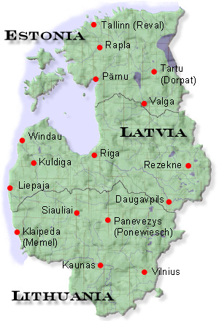
Trans-Baltic library trip for PhD students

Slide 4

The Idea
PhD students travel in groups across biggest Baltic academic libraries
1-2 days at the library: looking for books, using databases, gathering materials

Slide 5
The Idea
Introducing host university with their research topics
Building contacts and cooperation projects

Slide 6
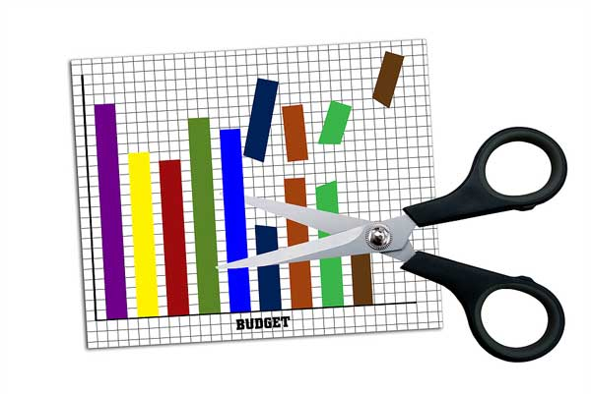
Why?
During recent years the budgets for library acquisitions were reduced
Local research results/publications has limited spread (e.g. grey literature)

Slide 7

Why?
PhD students and young scholars require
  Most recent publications
  Publications on specific and narrow topics
  Access to numerous databases

Slide 8

Why?
Opportunity to:
  Gather materials for research
  Present/test the research for other scholars and PhD students
  Build contacts

Slide 9
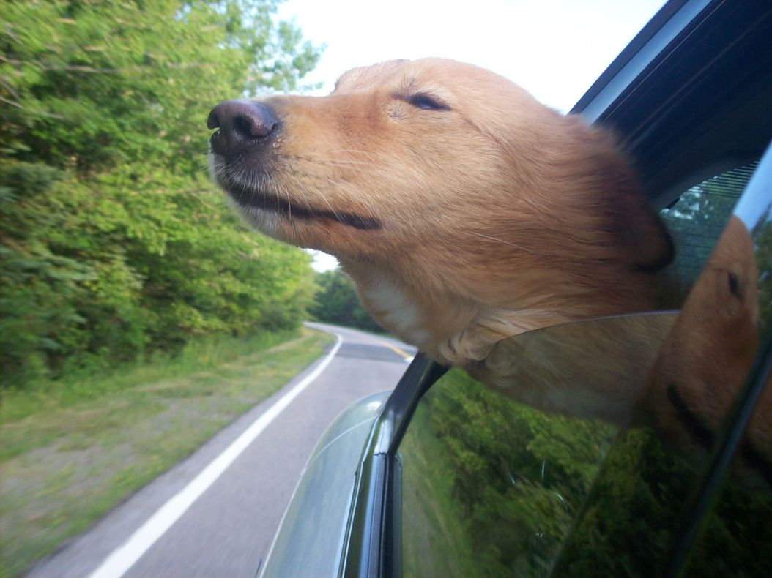
Why?
Galvas izvēdināšana
Galvos vėdinimas
Lõõgastus

Slide 10

How / When?
Just idea
Spread the word
Get opinion
Build contacts

Slide 11

Strenghts
Neighbourhood
Opportunity to gather valuable information
Good motivational activity
New contacts
Research testing
Cooperation (for libraries / for students)

Slide 12
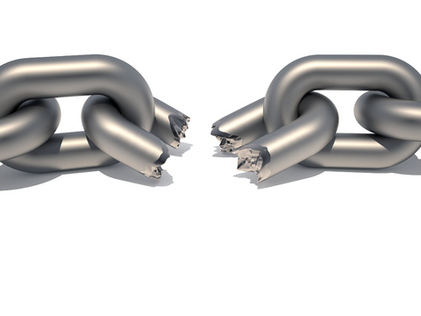
Weekneses
Organizational issues
  Transport
  Accomodation
  Coordination
Money
Big interest – low activity
Students unable to find time

Slide 13

Opportunities
Great cooperation experience
Resource sharing
Satisifed customers
Funding:
  100% institutions
  50/50 institutions/students
  x%/x%/x% institutions/students/ funds

Slide 14

Threats
Low activity
Lack of coordination
Lack of funding
Legal issues

Slide 15

Model
Sat. Arrivial, Welcome dinner, Accomodation
Mo. Work at the library
Tu. Work at the library
Sightseeing?
We. Seminar, Good-bye dinner, Departure

Slide 16

Some calculations
1 day of driving (½ + ½)
2 days at library
3 nights at dormitory / hostel
Breakfest / dinner
Riga-Tartu-Riga = 490 km
Vilnius-Riga-Vilnius = 586 km
Vilnius – Tartu – Vilnius = 1046 km

Slide 17
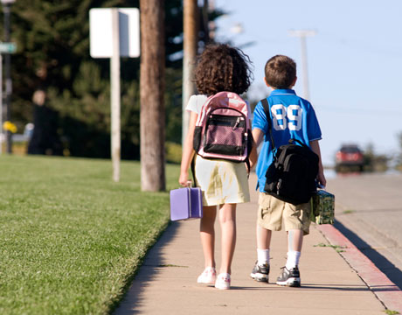
Homework
Take this idea with you
Think about it
Tell your colleagues, students, alumni and bosses
Do a survey
Wait for feedback
Let’s get back to it next year (or sooner)

Slide 18
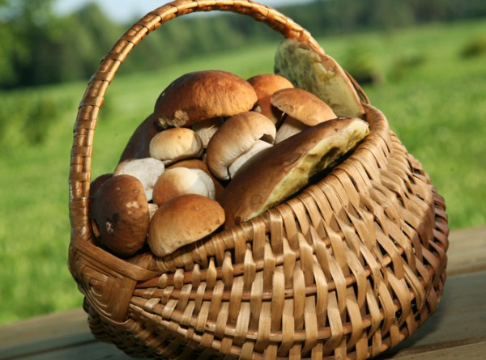
Thank You!
Janis.Kreicbergs@lu.lv

